Slide 1
Barriers and Pitfalls to Systemic Learning Analytics
Adam Cooper
Notes:
title slide
add title into box shown:
add presenters

Slide 2
Perspective of this Talk #1
Where am I coming from?
UK
Higher Ed
Institution
Cetis is based in the Institute for Educational Cybernetics at the University of Bolton.
“Our mission is to develop a better understanding of how information and communications technologies affect the organisation of education from individual learning to the global system.”

Slide 3
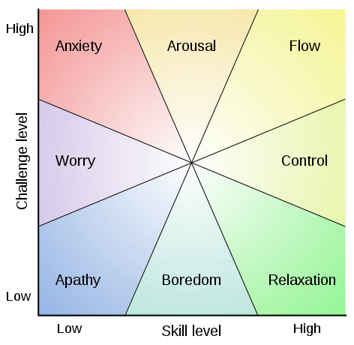
Perspectives of this Talk #2
Image: public domain, by Oliver Beatson; mental state according to Csikszentmihalyi's flow model

Slide 4
Structure of the Talk
Image: cbna Timothy Valentine
Practical Issues
Data Literacy and “Soft Capability”
The Management/Practice Accommodation
Potential Misadventure & Bad Role Models
Image: cba Jaskirat Singh Bawa

Slide 5
Practical Issues

Slide 6
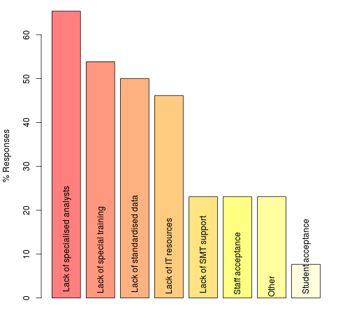
Obstacles to Analytics #1

Slide 7
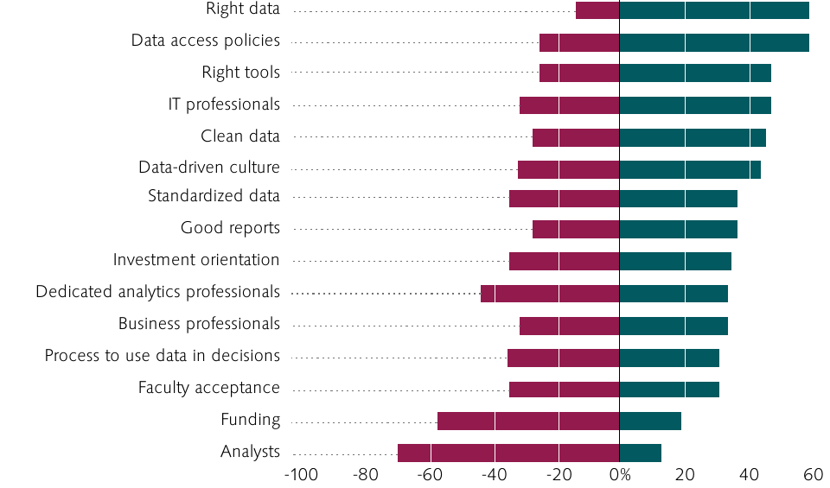
Obstacles to Analytics #2
From: “Analytics in Higher Education: Benefits, Barriers, Progress, and Recommendations” (ECAR Report)

Slide 8
These are mostly things you can:
Directly invest in
E.g. OU, statisticians and data wranglers (Friday session)
ECAR Survey Report 2012: “invest in people over tools... hiring and/or training... analysis”
Operate as a “shared service”
Predictive Analytics Reporting (PAR) Framework
Higher Education Statistics Agency (HESA)
Universities and Colleges Admissions Service (UCAS)

Slide 9
Data Literacy & “Soft capability”

Slide 10
Data Is Useless Without the Skills to Analyze It
‘...employees need to become: Ready and willing to experiment: Managers and business analysts must be able to apply the principles of scientific experimentation to their business. They must know how to construct intelligent hypotheses. They also need to understand the principles of experimental testing and design, including population selection and sampling, in order to evaluate the validity of data analyses.
... Adept at mathematical reasoning: How many of your managers today are really “numerate” — competent in the interpretation and use of numeric data?’
Jeanne Harris, HBR Blog, Sept 2012

Slide 11
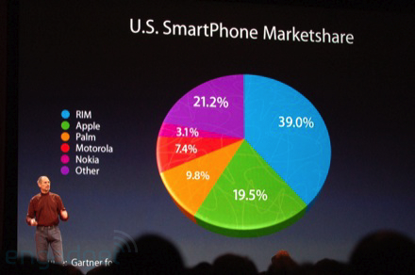
Visualisations are the Opium of the People
(c)2008, Ryan Block/Engadget

Slide 12
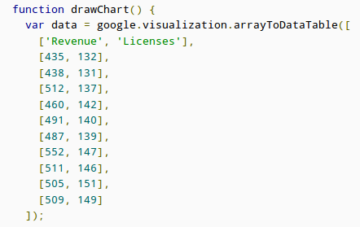
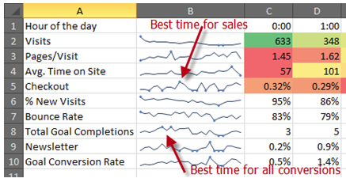
Sparklines: Tufte vs ...

Slide 13
Significance
“Flagged for action because 74% of students felt they were well supported by their supervisor compared to 80% in similar institutions (difference >5%)”
“We need to talk to Mr. Benn; the drop-out rate doubled in his class this year.”

Slide 14
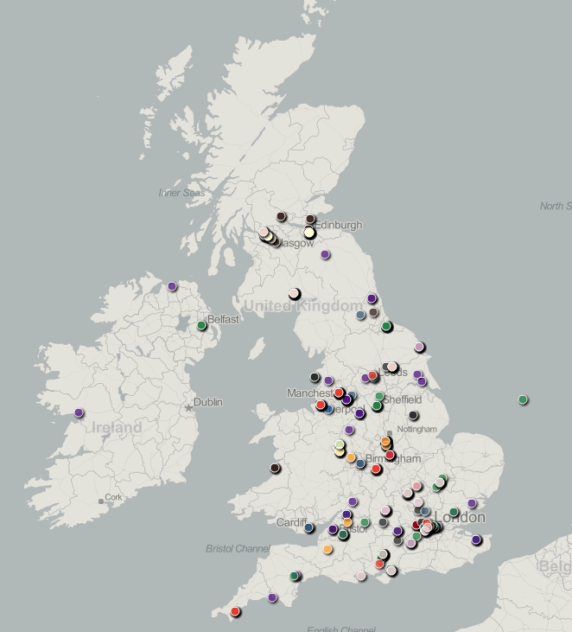
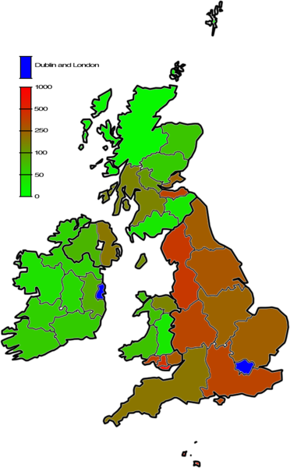

Slide 15
“Soft Capability”
Appreciation
Expertise to comprehend, query and converse vs originate
A role for amateurs
LA Innovation as social process
Small data done right (don’t wait for perfection)

Slide 16
Discussion Time

Slide 17
The management/ Practice Accommodation

Slide 18
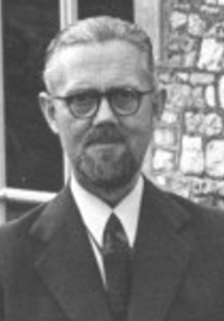
Ashby’s Law of Requisite Variety
“variety absorbs variety, defines the minimum number of states necessary for a controller to control a system of a given number of states”

Slide 19
The “Accommodation”
“The introduction of these techniques [Learning Analytics] cannot be understood in isolation from the methods of educational management as they have grown up over the past two centuries. These methods are conditioned by the fact that educational managers are limited in their capability to monitor and act upon the range of states which are taken up by teachers and learners in their learning activities. ... Over the years, an accommodation has developed between regulatory authorities, management and teaching professionals: educational managers indicate the goals which teachers and learners should work towards, provide a framework for them to act within, and ensure that the results of their activity meet some minimum standards. The rest is left up to the professional skills of teachers and the ethical integrity of both teachers and learners.”
Prof. Dai Griffiths, “Implications of Analytics for Teaching Practice in Higher Education”

Slide 20
So, you want to optimise student success?
What does success look like?
Really?
Says who?
Is a “good education” indicated by student success?
Are the following well-specified?
“optimise student success”
“maximise the probability of success”

Slide 21
Does everyone understand?
Attainment: an academic standard, typically shown by test and examination results
Progress: how far a learner has moved between assessment events
Achievement: takes into account the standards of attainment reached by learners and the progress they have made to reach those standards
Enrichment: the extent to which a learner gains professional attitudes, meta-cognition, technical or artistic creativity, delight, intellectual flexibility, ...

Slide 22
The Map is not the Territory
Image: Original René Magritte; digital image cbd Nad Renrel

Slide 23
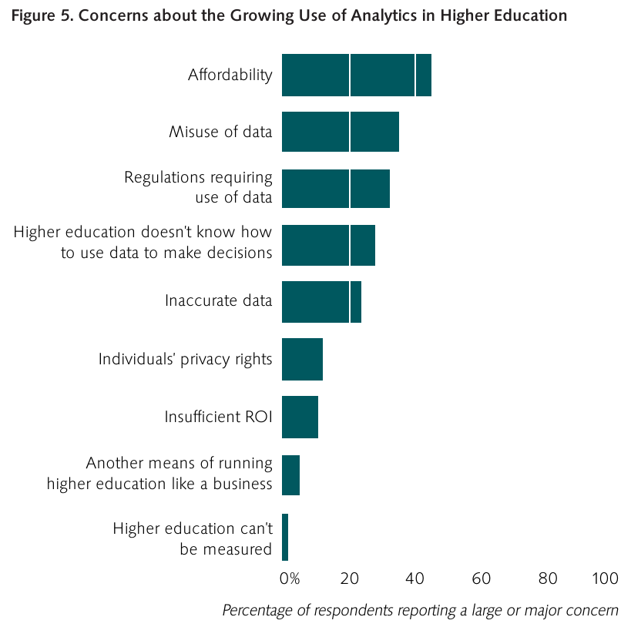
Worried?
From: “Analytics in Higher Education: Benefits, Barriers, Progress, and Recommendations” (ECAR Report)

Slide 24
Potential misadventure & bad Role Models

Slide 25
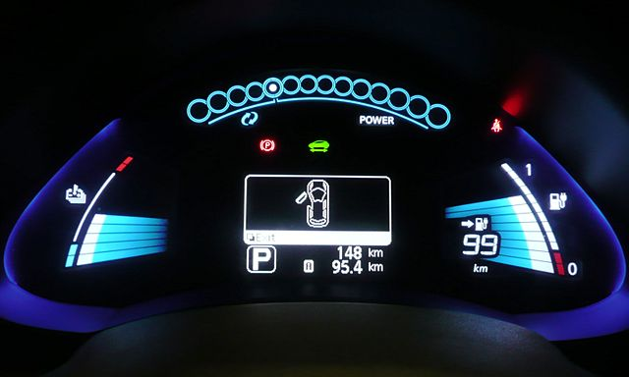
1. For What is this a Good Metaphor?

Slide 26
2. Automation and Practice
Automation can reduce variety (and it might be demonstrably effective) BUT...
In Systemic LA, “system” includes teaching practice.

Slide 27
3.The Folly of Technological Solutionism
‘Recasting all complex social situations either as neatly defined problems with definite, computable solutions or as transparent and self-evident processes that can be easily optimized—if only the right algorithms are in place!—this quest is likely to have unexpected consequences that could eventually cause more damage than the problems they seek to address.
I call the ideology that legitimizes and sanctions such aspirations “solutionism.” I borrow this unabashedly pejorative term from the world of architecture and urban planning, where it has come to refer to an unhealthy preoccupation with sexy, monumental, and narrow-minded solutions—the kind of stuff that wows audiences at TED Conferences—to problems that are extremely complex, fluid, and contentious … solutionism presumes rather than investigates the problems that it is trying to solve, reaching “for the answer before the questions have been fully asked.” How problems are composed matters every bit as much as how problems are resolved.’
Evgeny Morozov, “To Save Everything Click Here: The Folly of Technological Solutionism”, 2013

Slide 28
The Question Concerning Technology
‘Everywhere we remain unfree and chained to technology, whether we passionately affirm or deny it. But we are delivered over to it in the worst possible way when we regard it as something neutral; for this conception of it, to which today we particularly like to do homage, makes us utterly blind to the essence of technology.’
Martin Heidegger, “The Question Concerning Technology and Other Essays”, original 1954, quotation translated by William Lovitt 1977

Slide 29
4. The “What Works” Trap
RCTs show what works in social policy ...
Intelligent Tutoring Systems work ...
... don’t they?
Evidence-based policy is fashionable but, too often:
The scope & context of applicability is significant
Models of cause and effect are unexplored or ignored
Evidence relates to groups, not individuals
Is intuition worse than mis-made decisions on questionable evidence?

Slide 30
Rays of Sunshine
Phil Winne, SFU

Slide 31
That’s NOT what I meant!
The appropriation of current common practice in business intelligence and management reporting as the method of learning analytics.
KPIs, “learning metrics”
Reports
Dashboards
An industrial perspective on “systemic”
Epistemic blindness

Slide 32
A Counter-measure
Articulate the role of method, not only the outcome.
Organic development & prototyping
The principle of parsimony
Realistic about scale/quality of data
Design and develop with the educator IN the system
Optimise the environment, not the outcome
Reflect on the effect LA innovation has on practice

Slide 33
Discussion Time

Slide 34
Reading and References
Jacqueline Bichsel, “Analytics in Higher Education: Benefits, Barriers, Progress, and Recommendations” Available from http://www.educause.edu/ecar
Adam Cooper et al, “Survey of the State of Analytics in UK HE and FE institutions”
http://publications.cetis.ac.uk/2013/884
Jeanne Harris, “Data is Useless Without the Skills to Analyze it”
http://blogs.hbr.org/2012/09/data-is-useless-without-the-skills/
PAR Framework
http://wcet.wiche.edu/advance/par-framework
Dai Griffiths, “CETIS Analytics Series: The impact of analytics in Higher Education on academic practice”
http://publications.cetis.ac.uk/2012/532
Evgeny Morozov, “To Save Everything Click Here: The Folly of Technological Solutionism”
ISBN-10: 9781610391382
Phil Winne, “Improving Education” (lecture)
http://www.youtube.com/watch?v=dBxMZoMTIU4
Ray Pawson and Nick Tilley, “Realistic Evaluation”
ISBN-10: 0761950087 (and several openly available papers on the web)

Slide 35
^{Licence}
“Barriers and Pitfalls to Systemic Learning Analytics” by Adam Cooper, Cetis,
is licensed under the Creative Commons Attribution 3.0 Unported Licence
http://creativecommons.org/licenses/by/3.0/
^{http://www.cetis.ac.uk}
^{http://blogs.cetis.ac.uk/adam} a.r.cooper@bolton.ac.uk
Notes:
body copy no bullets

